Slide 1
Supervised Hebbian Learning
Chapter 7

Slide 2
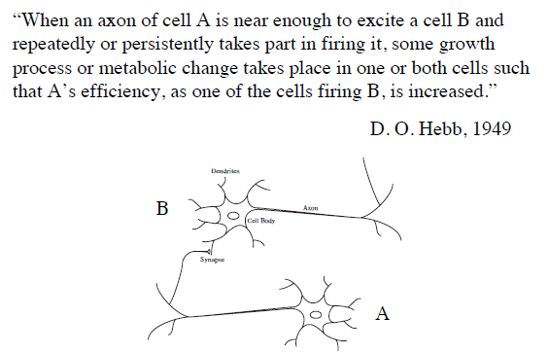
Hebb’s Postulate
Notes:
Give a brief overview of the presentation. Describe the major focus of the presentation and why it is important.
Introduce each of the major topics.
To provide a road map for the audience, you can repeat this Overview slide throughout the presentation, highlighting the particular topic you will discuss next.

Slide 3

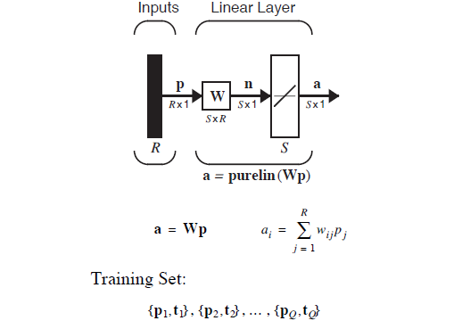
output vector a is determined from the input vector p according
Notes:
This is another option for an Overview slides using transitions.

Slide 4


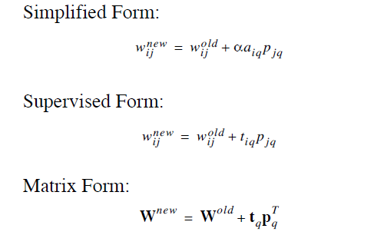
α is a positive constant, called the learning rate
For this chapter we will simplify Equation to the following form
The Hebb rule defined in Equation is an unsupervised learning rule. It does
not require any information concerning the target output
the Hebb rule for supervised learning, in which the target output is known for each input vector

Slide 5

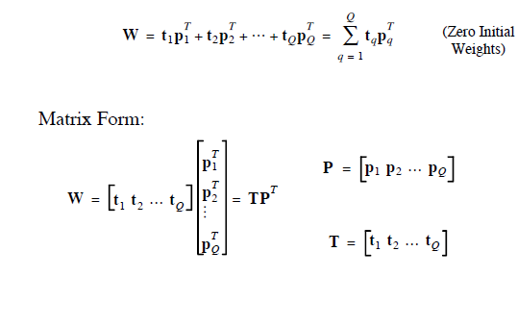
If we assume that the weight matrix is initialized to zero and then each of the Q input/output pairs are applied once to Eq. (7.7), we can write
This can be represented in matrix form:

Slide 6
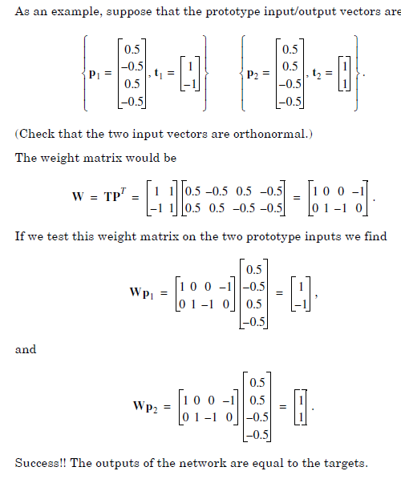
Example

Slide 7

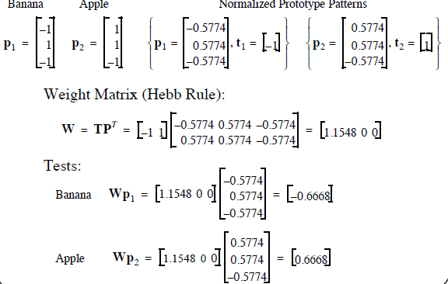
The outputs are close, but do not quite match the target outputs.

Slide 8

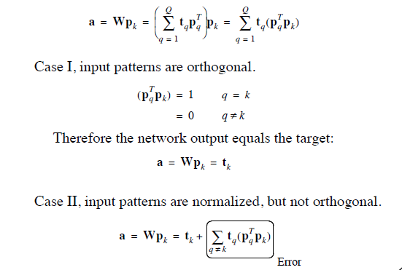
We analyze the performance of Hebbian learning for the linear associator. First consider the case where the vectors are orthonormal (orthogonal and unit length). If is input to the network, then the network output can be computed

Slide 9

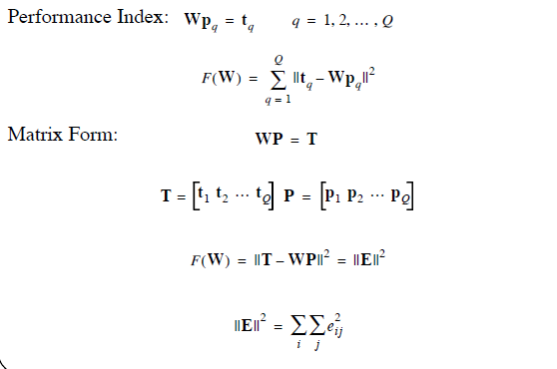
When the prototype input patterns are not orthogonal, the Hebb rule produces some errors. There are several procedures that can be used to reduce these errors

Slide 10

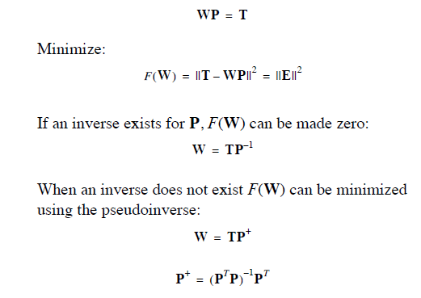

Slide 11
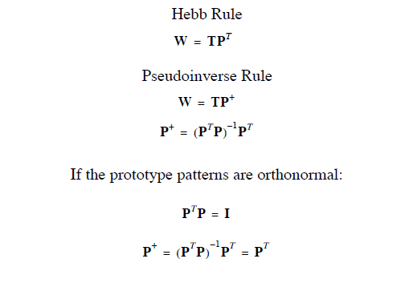

Slide 12

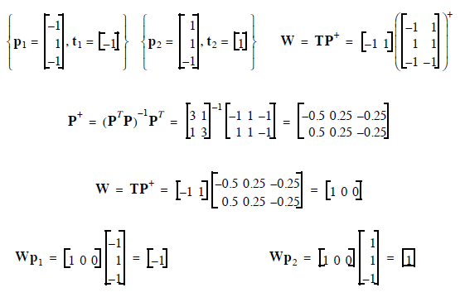

Slide 13

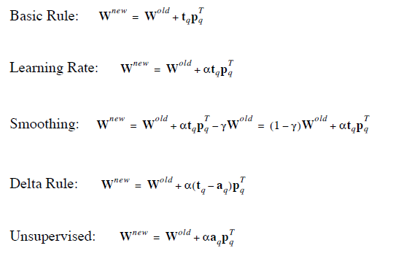

Slide 14
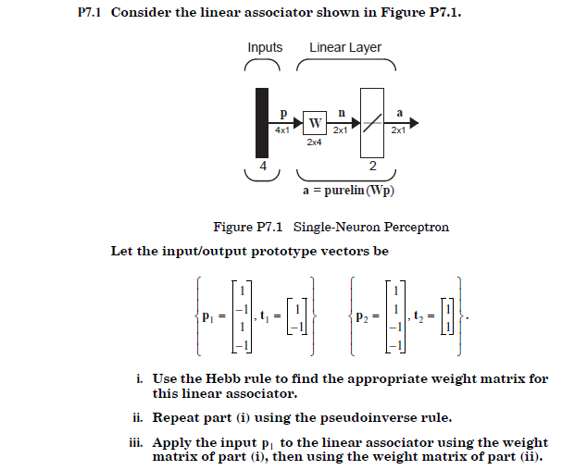
Problem 1

Slide 15

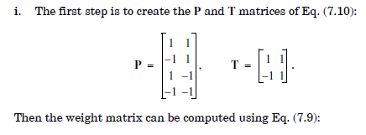
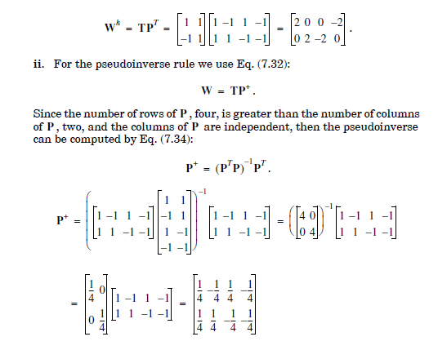

Slide 16
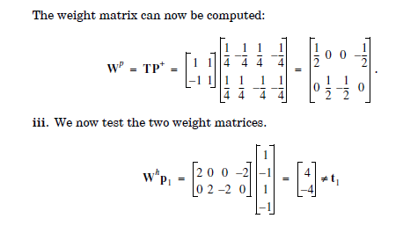
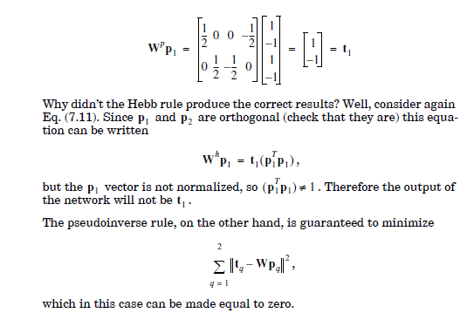

Slide 17
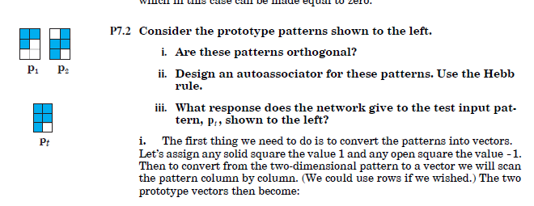

Problem 2

Slide 18
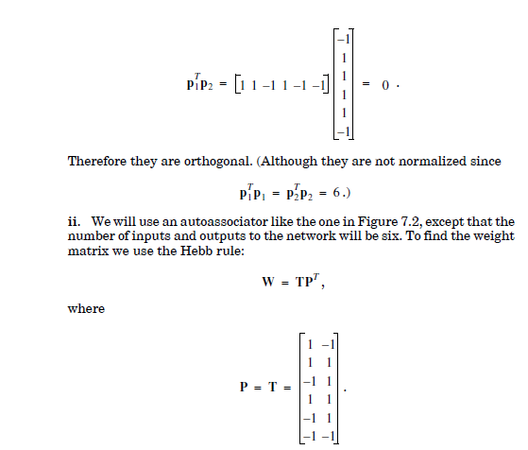
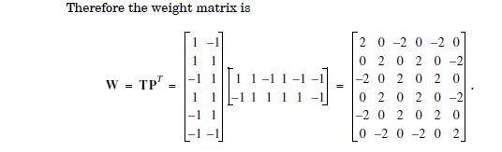

Slide 19
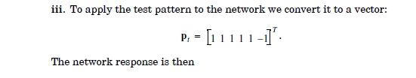
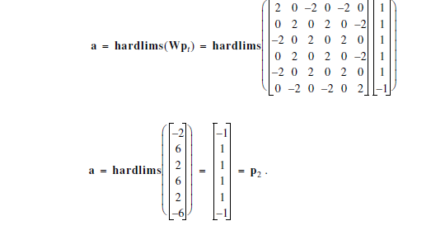

Slide 20
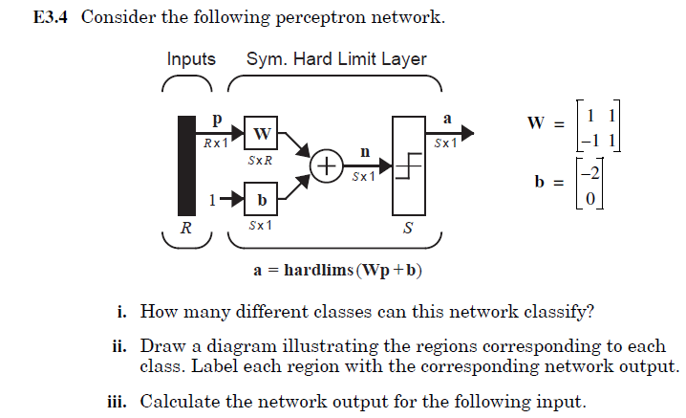

problems

Slide 21
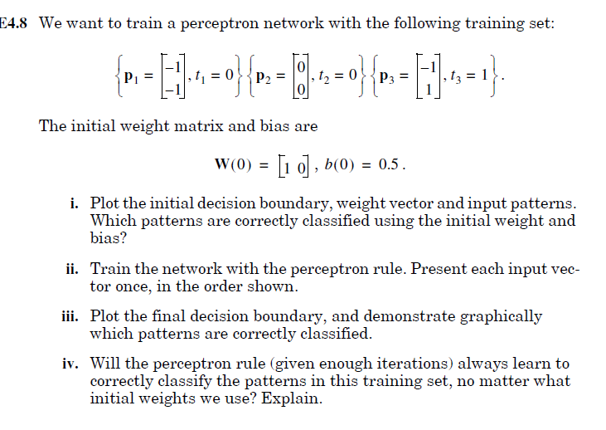
problems

Slide 22
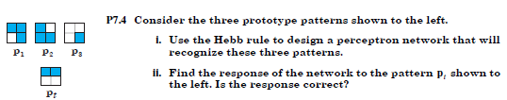

Slide 23
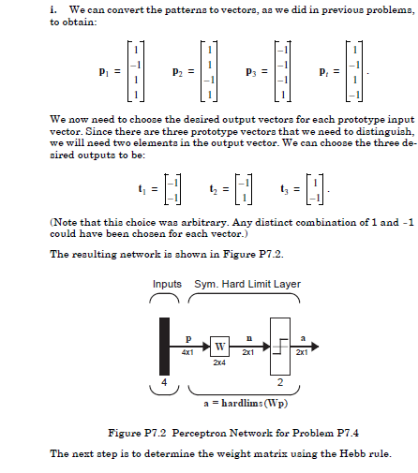

Slide 24
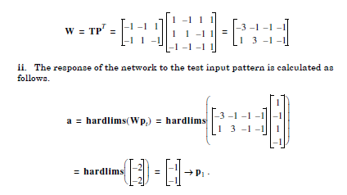


Slide 25
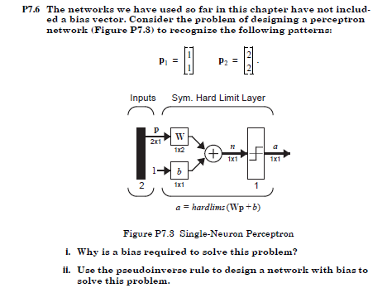

Slide 26
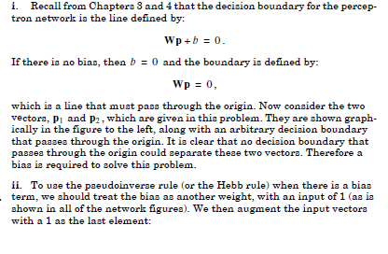

Slide 27
